Slide 1
COMPULSORY BRIEFING SESSION:
Tenders: WP0485 WTE and W1014 WTE
07 - 19 January 2015

Slide 2
Provisions and implications
WP0485 WTE:
Panel (46 entities) created in April 2013,
Following May 2014 general elections, DWS created (sanitation scope of work).
Decision taken and announced: Review of all panels.
W1014 WTE:
Initially advertised as separate competencies,
Advertised as combined tender (W0954 WTE) closed 12 June 2014,
Following May 2014 general elections, DWS created (sanitation scope of work).
Decision taken and announced: Cancellation, review specification and re-advertise.

Slide 3
Overview of the Department
Department of Water and Sanitation (DWS), Proclamation No. 37817, in terms of Constitution of the Republic (Act 108 of 1996).
DWS mandate: ensure that the nation’s water and sanitation infrastructure resources are protected, used, developed, conserved, managed and controlled in ways as set out in the National Water Act, 1998 (Act No. 36 of 1998) and the Water Services Act, 1997 (Act No. 108 of 1997).
Branches: National Water Resources Infrastructure and Sanitation Unit: jointly responsible for:
development, operations, maintenance and rehabilitation of national water and sanitation resources infrastructure assets,
Distribution of bulk (untreated/raw) water in terms of the National Water Act (NO. 36 of 1998) to authorised users.
These comprises of dams, tunnels, reservoirs, pipelines, hydro-mechanical equipment, cranes and lifting equipments, canals, pump stations, WWTPs, WTPs and associated infrastructure.

Slide 4
DWS Business definition
The aim of the Department of Water and Sanitation is to ensure the availability and supply of water and sanitation at national level, facilitate equitable and sustainable social and economic development, and ensure the universal and efficient supply of water and sanitation services at local level.
The Department’s core functions are: policy formulation, water resource management, infrastructure development, capacity building, intergovernmental and intra-sectoral coordination, and water regulation.

Slide 5
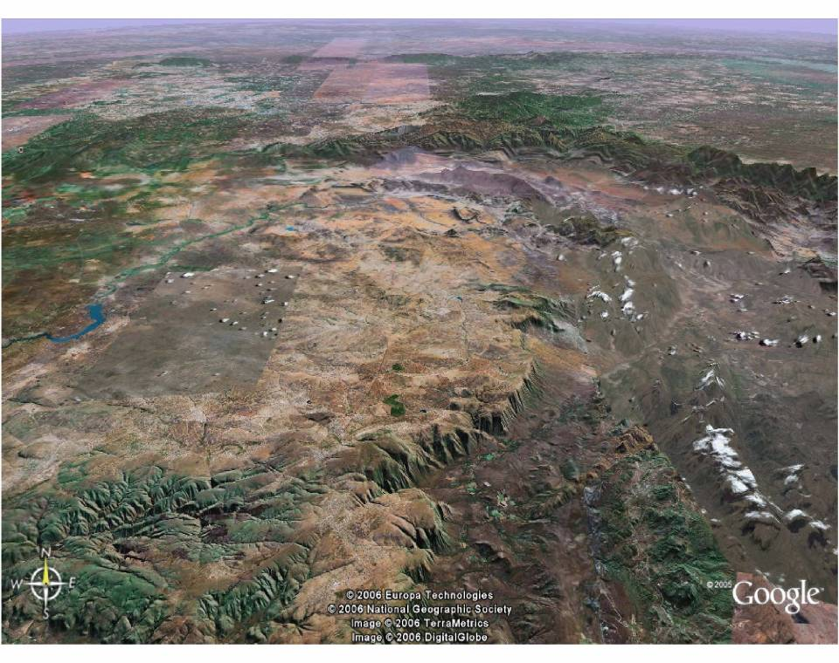
Olifants-Sand RWS
ORWSDP: WATER SERVICES DEVELOPMENT
POLOKWANE
MOKOPANE
STRYDPOORT MOUNTAINS
LEBOWAKGOMO
Olifantspoort South RWS
Lebalelo RWS
Mphahele and Groothoek RWS
MOOIHOEK
BURGERSFORT
JANE FURSE
Tubatse RWS
Flag Boshielo RWS
STEELPOORT TOWN
FLAG BOSHIELO DAM
Nebo Plateau RWS
DE HOOP DAM
MOTOTOLO
LEGEND
SUPPLY AREAS
EXISTING BULK WATER PIPELINES
ORWRDP PIPELINES
WATER SERVICES BULK PIPELINES
ESKOM PSS INFRASTUCTURE
EPSS
5
Notes:
Olifants River Water Resources Development Project (ORWRDP)
ORWRDP: ROF meeting
5

Slide 6
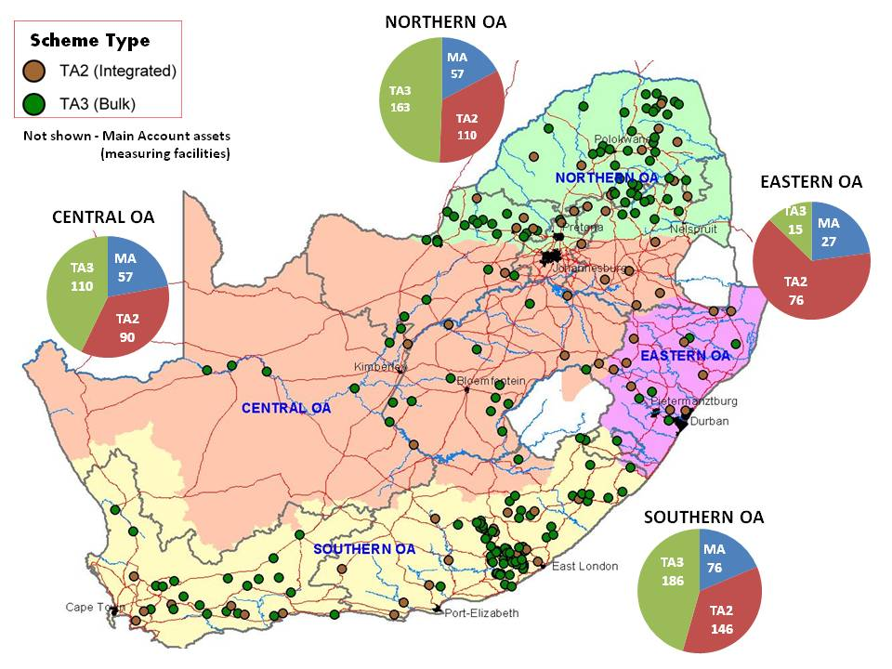
Existing Infrastructure
6

Slide 7
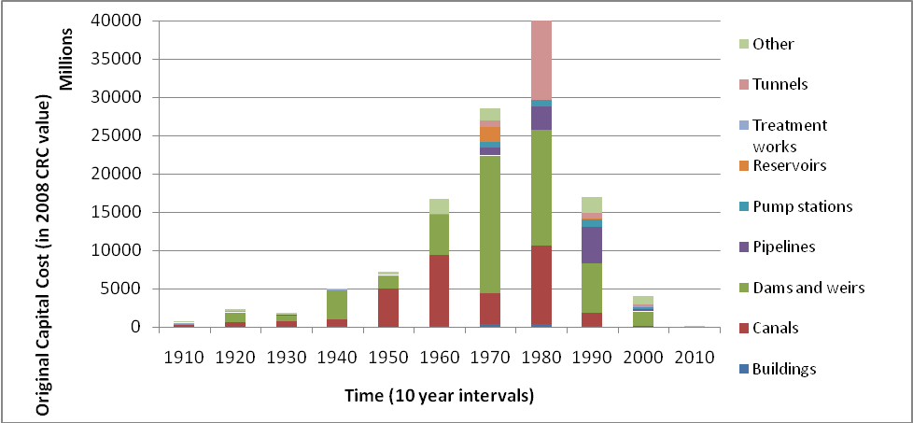
3.1 Age Profile of Assets
7

Slide 8
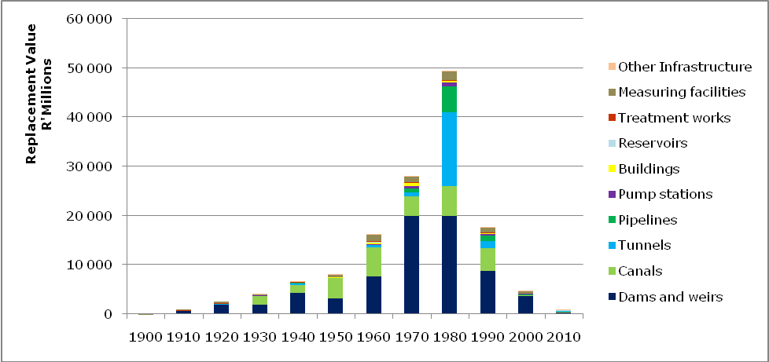
3.2 Age profile of assets
8

Slide 9
Major Programmes
Dam Safety and Rehabilitation Programme (DSRP)
Regional Bulk Infrastructure Grant (RBIG)
Bucket Eradication Programme (Sanitation)
Accelerated Community Infrastructure Programme (ACIP)
Adopt-a-River Programme
Rain Water Harvesting

Slide 10
Sourcing of services
Current procurement system: in terms of PFMA and PPPFA per project (contractors)
Challenges:
time wasted on SCM processes; delays in projects; poor contract management; over-utilisation of established companies; lack of competition in the sector; extent of fronting and lack of skills transfer to emerging entities
10

Slide 11
W1014 WTE:
CIVIL, MECHANICAL, ELECTRICAL AND SPECIALIST WORKS CONTRACTORS INTO A PANEL OF PREFERRED CONTRACTORS FOR NEW WORKS, EMERGENCY AND MAINTENANCE WORKS (WATER AND SANITATION) FOR A PERIOD OF THREE (3) YEARS
11

Slide 12
Requirements
Envisaged system: pre-approved database of Contractors for 3 years
Required CIDB grades and designations:
Minimum Grade Four (4)
Grades 4-6 ring-fenced for contractor development
Designations: civil, mechanical and electrical.
Specialist works: SD, SE, SL, SQ, SO
Pre-approved PSPs to be called as an when they are needed;
Contracts will be used to pave entry for emerging service providers and entities owned and managed by historically disadvantaged individuals (HDIs),
12

Slide 13
Evaluation criteria
3-phased evaluation
Functionality:
Approach Paper – Method Statement
Tenderer’s Experience
Contractor’s Resources – Personnel and Plant
Quality Control Procedures
Health and Safety procedures proposed for the Contract
Risk Management Process
Financial Capability
Minimum threshold:
55% for CIDB Grade 4, 65% for CIDB Grade 5-6 and 75% for CIDB Grade 7-9
13

Slide 14
WP0485 WTE:
PROFESSIONAL SERVICES PROVIDERS (PSP) TO RENDER PROFESSIONAL MULTI-DISCIPLINARY SERVICES COVERING: CIVIL, STRUCTURAL, MECHANICAL, ELECTRICAL ENGINEERING, ARCHITECTURAL SERVICES, ARCHAEOLOGICAL AND ENVIRONMENTAL SERVICES, CONTRACT AND PROJECT MANAGEMENT SERVICES FOR A PERIOD OF THREE (3) YEARS FOR THE DEPARTMENT OF WATER AND SANITATION (DWS)

Slide 15
Requirements
Envisaged system: pre-approved database of PSP to add to the existing Panel
Required services:
Design, Draughting services, Site supervision, Plant/site inspections (Mechanical/Electrical), Training of DWA personnel, Project/Programme and Contract management, Quantity surveying, Review of specifications, updating/development of plant log books, Environmental authorisations, Dam Safety assessments, Probabilistic evaluations, Geophysical investigations, Monitoring of dams, Maintenance plans, Operation and Maintenance Manuals and Monitoring of conveyance structures and systems
15

Slide 16
Evaluation criteria
3-phased evaluation
Functionality:
Minimum PI insurance – each Category
Criteria for each Category
Minimum functionality threshold
Professionals: CVs and certified copies of qualifications
Experience: relevance
Price
Rates: ECSA/DPSA
All bidders receive 90 points for price
16

Slide 17
Enquiries:
MdletsheM@dwa.gov.za
(Technical enquiries only)
THANK YOU

